Slide 1
Microsoft Cognitive Services: Infuse intelligence into your business app with Vision and Speech
BRK3296
Jennifer Marsman
Principal Software Development Engineer
http://blogs.msdn.microsoft.com/jennifer
Twitter: @JenniferMarsman

Slide 2






Microsoft Cognitive Services
Give your apps a human side
Vision
From faces to feelings, allow your apps to understand images and video
Speech
Hear and speak to your users by filtering noise, identifying speakers, & understanding intent
Language
Process text and learn how to recognize what users want
Knowledge
Tap into rich knowledge amassed from the web, academia, or your own data
Search
Access billions of web pages, images, videos, and news with the power of Bing APIs
Labs
An early look at emerging Cognitive Services technologies: discover, try & give feedback on new technologies before general availability

Slide 3
Microsoft Cognitive Services
Give your apps a human side
Computer Vision
Content Moderator
Emotion
Face
Video
Video Indexer
Custom Vision Service
Bing Speech
Speaker Recognition
Translator Speech
Custom Speech Service
Bing Spell Check
Linguistic Analysis
Text Analytics
Translator Text
Web Language Model
Language Understanding
Academic Knowledge
Entity Linking
Knowledge Exploration
Recommendations
QnA Maker
Custom Decision Service
Bing Autosuggest
Bing Image Search
Bing News Search
Bing Video Search
Bing Web Search
Bing Entity Search
Bing Custom Search
Project Prague (gesture)
Project Cuzco (events)
Project Johannesburg (routing)
Project Nanjing (isochrones)
Project Abu Dhabi (distance matrix)
Project Wollongong (location)
Vision
Speech
Language
Knowledge
Search
Labs

Slide 4
Microsoft Cognitive Services
Give your apps a human side
Vision
Speech
Language
Knowledge
Search
Labs
Computer Vision
Content Moderator
Emotion
Face
Video
Video Indexer
Bing Speech
Speaker Recognition
Translator Speech
Bing Spell Check
Linguistic Analysis
Text Analytics
Translator Text
Web Language Model
Academic Knowledge
Entity Linking
Knowledge Exploration
Recommendations
QnA Maker
Bing Autosuggest
Bing Image Search
Bing News Search
Bing Video Search
Bing Web Search
Bing Entity Search
Project Prague (gesture)
Project Cuzco (events)
Project Johannesburg (routing)
Project Nanjing (isochrones)
Project Abu Dhabi (distance matrix)
Project Wollongong (location)
CUSTOMIZATION
Custom Vision Service
Custom Speech Service
Language Understanding
Custom Decision Service
Bing Custom Search

Slide 5








Why Microsoft Cognitive Services?
Easy
Flexible
Tested
Roll your own with REST APIs
Simple to add: just a few lines of code required
Integrate into the language and platform of your choice
Breadth of offerings helps you find the right API for your app
Bring your own data for your custom experience
Built by experts in their field from Microsoft Research, Bing, and Azure Machine Learning
Quality documentation, sample code, and community support
GET A KEY
BUILD

Slide 6









A variety of real-world applications
Vision
Speech
Language
Knowledge
Search
What is in the image?
Give me directions to the nearest local branch.
Play today’s customer call recording.
Top publications in customer lifecycle trends?
Search for ‘fraud prevention’
Computer Vision
Bing Speech
Language Understanding
Knowledge Exploration
Bing News Search
Natural Language Processing
Here are the top results:
Here is what I found:
Intent: PlayCall
Content: Customer#
DateTime.date: today
Customer Relationship Management – 5 Key Trends for 2014 CRM
Oct 28, 2015 – Here are FIVE key trends in 2014 that would help marketers in rolling ... Of late, marketers are looking at customer lifecycle management (CLM)
Information Communications Media Market News
It also investigates the top three expected Fraud Detection and Prevention programs, in terms of demand in key markets…
Predictive Customer Lifecycle Management (CLM)
The purpose of Customer Life-cycle Management (CLM) is to maximize both customer retention and .... Predictive trend analysis provides business visibility.
The Big Question: In-House or Outsourced Fraud Protection?
First, let’s point out that there is not one absolute answer—there are “pros” and “cons” to each. Those who favor in-house…
Category | People; 5 faces
Adult/Racy? | False/False
Dominant colors
Accent color
Convert spoken audio to text
Trends 2016: The Future of Customer Service
Jan 5, 2016 – The top 10 customer service trends for 2016 that .... North American Consumer
How to Protect Your Business from Online Fraud this Holiday Season
Michael heads fraud prevention tool. Online and mobile shopping are expected to continue growing apace…
Convert text to spoken audio
Now Playing
Extract intent of user
11/29/2016 Customer Call
Language Around Customer Lifecycles in the Banking Industry
View PDF

Slide 7
How do I use them?
using Microsoft.ProjectOxford.Vision;
using Microsoft.ProjectOxford.Vision.Contract;
AnalysisResult analysisResult;
var features = new VisualFeature[] { VisualFeature.Tags, VisualFeature.Description };
using (var fs = new FileStream(@"C:\Vision\Sample.jpg", FileMode.Open))
{
analysisResult = await visionClient.AnalyzeImageAsync(fs, features);
}
{
"tags": [
{ "name": "outdoor",
"score": 0.976 },
{ "name": "bird",
"score": 0.95 } ],
"description":
{ "tags":
[ "outdoor", "bird" ],
"captions": [
{ "text”: “partridge
in a pear tree”,
“confidence”: 0.96 }
]
}
}
POST https://api.projectoxford.ai/vision/v1.0/analyze?visualFeatures=Description,Tags
&subscription-key=<Your subscription key>

Slide 8
Vision

Slide 9








Vision
Computer Vision API
Face API
Emotion API
Video API
Distill actionable information from images
Detect, identify, analyze, organize, and tag faces in photos
Personalize experiences with emotion recognition
Analyze, edit, and process videos within your app
Content Moderator
Custom Vision Service
Video Indexer
Machine-assisted moderation of text and images, augmented with human review tools
Customizable web service that learns to recognize specific content in imagery
Process and extract smart insights from videos

Slide 10


Computer Vision API
Analyze an image
Understand content within an image
OCR
Detect and recognize words within an image
Generate thumbnail
Scale and crop images, while retaining key content
Recognize celebrities
Thanks to domain specific models, ability to recognize 200K celebrities from business, politics, sports, and entertainment around the world

Slide 11
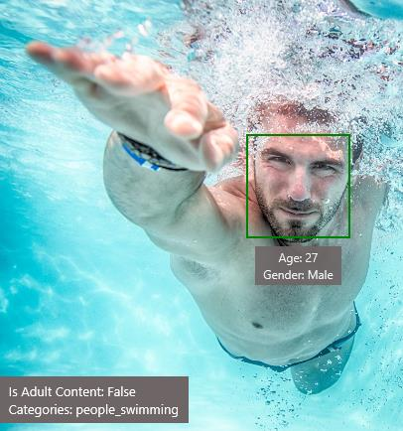
Analyze image
Type of image
Clip Art Type 0 Non-clipart
Line Drawing Type 0 Non-Line Drawing
Black & White Image False
Content of image
Categories [{ “name”: “people_swimming”, “score”: 0.099609375 }]
Adult Content False
Adult Score 0.18533889949321747
Faces [{ “age”: 27, “gender”: “Male”, “faceRectangle”: {“left”: 472, “top”: 258, “width”: 199, “height”: 199}}]
Image colors
Dominant Color Background White
Dominant Color Foreground Grey
Dominant Colors White
Accent Color

Slide 12

OCR
JSON:
{
"language": "en",
"orientation": "Up",
"regions": [
{
"boundingBox": "41,77,918,440",
"lines": [
{
"boundingBox": "41,77,723,89",
"words": [
{
"boundingBox": "41,102,225,64",
"text": "LIFE"
},
{
"boundingBox": "356,89,94,62",
"text": "IS"
},
{
"boundingBox": "539,77,225,64",
"text": "LIKE"
}
. . .

Slide 13
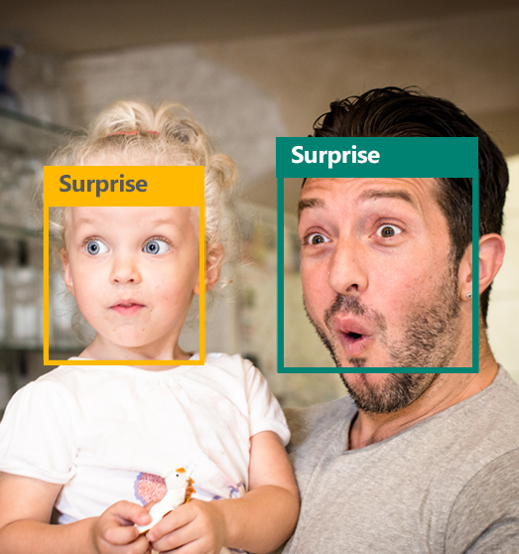

Emotion API
Face detection
"faceRectangle": {"width": 193, "height": 193, "left": 326, "top": 204} …
Emotion scores
"scores": { "anger": 5.182241e-8,
"contempt": 0.0000242813,
"disgust": 5.621025e-7,
"fear": 0.00115027453,
"happiness": 1.06114619e-8,
"neutral": 0.003540177,
"sadness": 9.30888746e-7,
"surprise": 0.9952837}

Slide 14


Face API
Face detection
Detect faces and their attributes within an image
Face verification
Check if two faces belong to the same person
Similar face searching
Find similar faces within a set of images
Face grouping
Organize many faces into groups
Face identification
Search which person a face belongs to

Slide 15




Face API
Detection
"faceRectangle": {"width": 193, "height": 193, "left": 326, "top": 204} …
Feature attributes
"attributes": { "age": 42, "gender": "male",
"headPose": { "roll": "8.2", "yaw": "-37.8", "pitch": "0.0" }}
Grouping
Identification
Jasper Williams

Slide 16
Demo
Face and Emotion: http://microsoft.com/cognitive
Intelligent Kiosk: http://aka.ms/kioskapp

Slide 17

Video Indexer Unlock video insights
Upload your video and go
Start turning your video into insights right away.
Make your content more discoverable
Quickly and easily extract insights such as spoken words, faces, characters, and emotions
Improve engagement with your video
Metadata extracted by Video Indexer can be used to build powerful engagement experiences with recommendations, highlight clips, and interactive videos

Slide 18
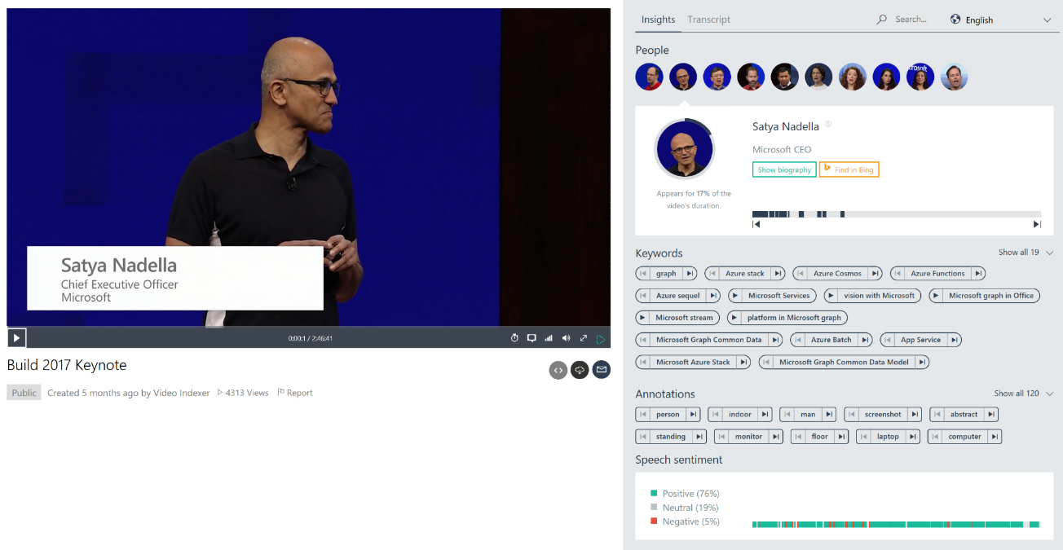

Slide 19
Demo
Video Indexer: http://vi.microsoft.com

Slide 20
Best practices for Devs
Samples and SDKs exist
For ObjectiveC/Swift/iOS, Java/Android, C#/Windows, and Python (Jupyter notebook)
https://www.microsoft.com/cognitive-services/en-us/SDK-Sample?api=computer%20vision
Limitations
Computer Vision API describes images in English only
Face API detects up to 64 human faces in one image
Facial detection: JPEG, PNG, GIF (first frame), and BMP supported, image file size of 1KB-4MB, detectable face size 36x36-4096x4096 pixels, returned faces ordered by face rect size desc
Fun random details
FindSimilarFace has 2 modes: matchPerson (default, same person) and matchFace (similar faces)
FaceGroup API takes between 2-1000 candidate faces
Documentation: https://www.microsoft.com/cognitive-services/en-us/documentation

Slide 21
Data
Computer Vision
Description, tags, clip art, line drawing, black & white, IsAdultContent/Score, IsRacy/Score, categories, faces, dominant colors, accent color
https://www.microsoft.com/cognitive-services/en-us/computer-vision-api
Emotions
Anger, contempt, disgust, fear, happiness, sadness, surprise, and neutral
https://www.microsoft.com/cognitive-services/en-us/emotion-api
Face
Bounding box, 27 facial landmarks, age, gender, head pose, smile, facial hair, glasses
https://www.microsoft.com/cognitive-services/en-us/face-api

Slide 22


“Thousands of partners sign in to our platform every hour. The response time from the Face API is incredible, enabling us to verify our drivers without slowing them down.”
Dima Kovalev, Product Manager, Uber
Face API
Read case study here
See video here

Slide 23

“We found Cognitive Services to be the missing piece in the equation, the one that we needed to bring this solution to market and really revolutionize the way people look at video.”
Katie McCann, Vice President of Product and Engineering, Prism Skylabs
Computer Vision API
Read case study here
See video here

Slide 24

“We were solving a specific problem to bring value to our customers, and we wanted a quick, elegant, and simple solution. We found it in Cognitive Services.”
Aaron Edell, Chief Product Owner, GrayMeta
Computer Vision API
Read case study here

Slide 25
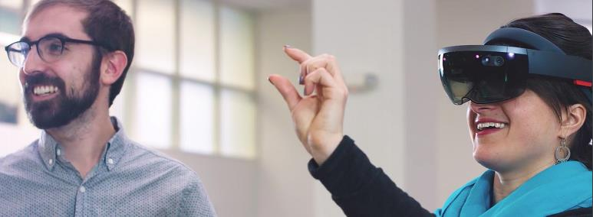

Brainshark
Power your Content. Power your Sales.
Problem
Training sales people through experience is ridiculously expensive. Every deal lost due to lack of confidence costs the company real money.
Solution
Create a training platform that allows sales reps to perfect their pitch through video and Cognitive Services. Utilizing Face API, Emotion API, and Text Analytics, we both analyze their pitch, and feed an ML model to provide feedback on their performance.
“Now, companies are simply pushing sales people into the field and they’re learning through experience— a ridiculously expensive way to train. Every deal lost due to lack of confidence costs the company real money. If we can minimize that and actually get sales people ready to sell, it’ll have a huge impact on productivity,”
Jim Ninivaggi Senior Vice President Business Development

Slide 26
Custom Vision Service

Slide 27


Custom Vision Service
A customizable web service that learns to recognize specific content in imagery
Upload Images Upload your own labeled images, or use Custom Vision Service to quickly tag any unlabeled images.
Train Use your labeled images to teach Custom Vision Service the concepts you want it to learn.
Evaluate Use simple REST API calls to quickly tag images with your new custom computer vision model.
Active learning Images evaluated through your custom vision model become part of a feedback loop you can use to keep improving your classifier.

Slide 28




What is it?
Custom Vision Service is an easy-to-use tool for prototyping, improving, and deploying a custom image classifier to a cloud service, without any background in computer vision or deep learning required.
“cat”
Custom Vision
Model
“dog”
“dog”

Slide 29

Export models to mobile!
Announcement: https://aka.ms/cvsexport
Sample: https://github.com/Azure-Samples/cognitive-services-ios-customvision-sample
Xamarin port: https://github.com/Xamarin/ios-samples/tree/master/ios11/CoreMLAzureModel

Slide 30
Demo
Dog vs. cat classifier: http://customvision.ai
Intelligent Kiosk: https://aka.ms/kioskapp
Export to CoreML on iOS11: https://aka.ms/cvsexport

Slide 31
Best Practices for using Custom Vision
Use at least 30 images for each tag
Images should be the focus of the picture
Use sufficiently diverse images and backgrounds (ex: cats with red background and dogs with blue background)
Train with images that are similar in {quality, resolution, lighting, etc.} to the images that will be used in prod
Supports Microsoft accounts (MSA) and AAD

Slide 32
Gotchas to watch for
V1 doesn’t currently do object detection with bounding boxes within an image
Intended to be robust to subtle differences, so V1 is not well suited to tasks like defect detection/quality assurance
Current project limitations while in preview: 1000 images, 50 tags, 20 iterations saved
Current account limitations while in preview: 20 projects, 1000 predictions per day

Slide 33
Example Customer Scenarios
Customer Support
Enable a customer to identify a product for support by taking a photo. No finding the manual or pulling the appliance out to identify it!
Service Engineers
Identify parts for ordering
Manufacturing
Fault detection on assembly lines to avoid machine downtime and drop in production rates (provided differences are obvious)
Data Scientists
Automatic tagging instead of manual, to create features or labels

Slide 34
Resources: Custom Vision Service
Get started at http://customvision.ai
Build 2017 Talk: https://channel9.msdn.com/Events/Build/2017/T6022
Programmatic API access using C# (Python and Node SDKs coming soon): https://github.com/Microsoft/Cognitive-CustomVision-Windows

Slide 35
Speech

Slide 36



Speech
Bing Speech API
Speaker Recognition API
Custom Speech Service
Convert speech to text and back again, and understand its intent
Give your app the ability to know who's talking
Fine-tune speech recognition for anyone, anywhere

Slide 37
Demo
Speech: http://dictate.ms in Office
Speaker Recognition: http://microsoft.com/cognitive

Slide 38
Custom Speech Service

Slide 39


Custom Speech Service
Customize both language and acoustic models
Tailor speech recognition to your app and environment

Slide 40
Custom Speech Service
Record audio
Create custom language models for the vocabulary of the application
Adapt acoustic models to better match the expected environment of the application’s users
Deploy to a custom endpoint and access from any device
Transcribe
Adapt
Deploy

Slide 41


“The only reason we can build a product like this is because we are building on the deep learning and speech recognition expertise at Microsoft to deliver an entertainment experience that will be revolutionary.”
Alexander Mejia, Owner and Creative Director, Human Interact
Custom Speech Service, LUIS
Read case study here
See video here

Slide 42
Example Customer Scenarios
“Hands Free” or Kiosk scenarios across Manufacturing, Retail, etc.
Drive Through
Call Center

Slide 43
Code Sample
Biology sample data: https://github.com/Microsoft/Cognitive-Custom-Speech-Service
Walkthrough: https://docs.microsoft.com/en-us/azure/cognitive-services/custom-speech-service/cognitive-services-custom-speech-get-started
Service creation: http://cris.ai

Slide 44
Demo
Biology data: https://cris.ai/AccuracyTests
Airport Kiosk

Slide 45
Summary

Slide 46
Microsoft Cognitive Services
Give your apps a human side
Vision
Speech
Language
Knowledge
Search
Labs
Computer Vision
Content Moderator
Emotion
Face
Video
Video Indexer
Bing Speech
Speaker Recognition
Translator Speech
Bing Spell Check
Linguistic Analysis
Text Analytics
Translator Text
Web Language Model
Academic Knowledge
Entity Linking
Knowledge Exploration
Recommendations
QnA Maker
Bing Autosuggest
Bing Image Search
Bing News Search
Bing Video Search
Bing Web Search
Bing Entity Search
Project Prague (gesture)
Project Cuzco (events)
Project Johannesburg (routing)
Project Nanjing (isochrones)
Project Abu Dhabi (distance matrix)
Project Wollongong (location)
CUSTOMIZATION
Custom Vision Service
Custom Speech Service
Language Understanding
Custom Decision Service
Bing Custom Search

Slide 47
Resources
Website: http://microsoft.com/cognitive
UserVoice: https://cognitive.uservoice.com
StackOverflow tag: microsoft-cognitive
Microsoft Ignite content can be found at https://channel9.msdn.com/Events/Ignite

Slide 48
Resources: Cognitive Services
Microsoft Cognitive Services Developer Code of Conduct: https://azure.microsoft.com/en-us/support/legal/developer-code-of-conduct
Microsoft Cognitive Services Terms - applicable to free previews, excluding generally available Microsoft Azure and Volume Licensing
https://go.microsoft.com/fwlink/?LinkId=533207
Online Services Terms – applicable to generally available Cognitive Services use via Microsoft Azure or Volume Licensing (once available)
http://www.microsoftvolumelicensing.com/DocumentSearch.aspx?Mode=3&DocumentTypeId=31

Slide 49
Please evaluate this session
From your
Please expand notes window at bottom of slide and read. Then Delete this text box.
PC or tablet: visit MyIgnite https://myignite.microsoft.com/evaluations
Phone: download and use the Microsoft Ignite mobile app https://aka.ms/ignite.mobileapp
Your input is important!

